Slide 1

Y6 Information for parents
2023

Slide 2
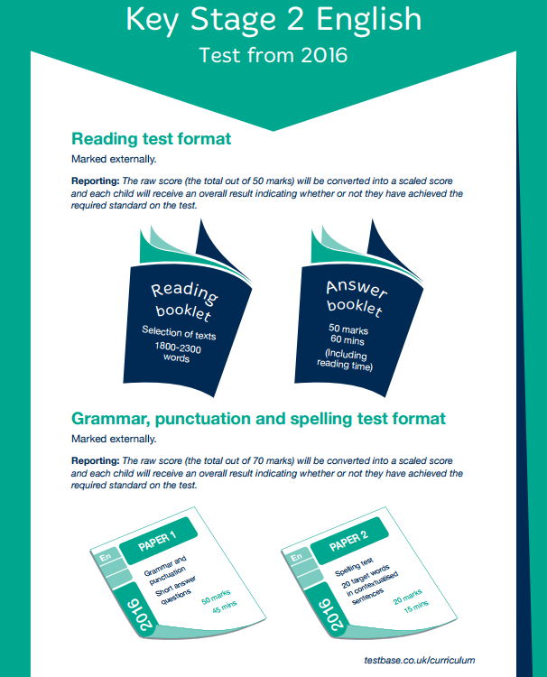
SATs

Slide 3
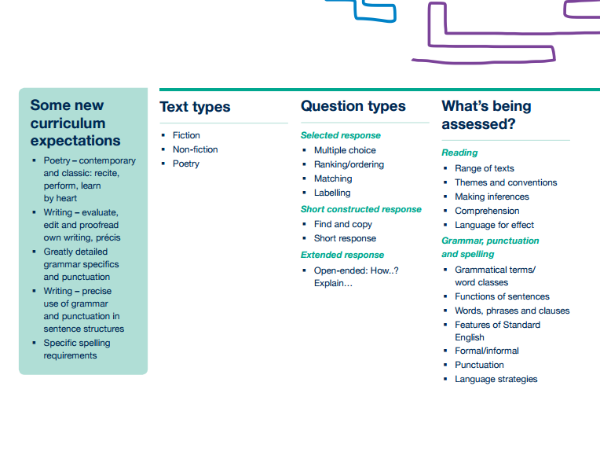
Home/School Diary

Slide 4

It is not just about lots of reading at home: the children must discuss the specific use of language and find other words which have the same meaning.
Use a thesaurus to understand writer’s use of language.
Discuss correct context for words.

Slide 5
The impact of reading at least 20 minutes per day:
You are exposed to 1.8 million words per year.
You will score in the top 10% of standardised tests.

Slide 6
The impact of reading 5 minutes per day:
You are exposed to 282,000 words per year.
You will score in the top 50% of standardised tests.

Slide 7
The impact of reading 1 minute per day:
You are exposed to 8,000 words per year.
You will score in the bottom 10% of standardised tests.

Slide 8
Children to read at least 5 times per week (20 mins if possible).
Please sign and comment in your child’s diary.
Reading challenge – “bingo grid” at the back of diary. Read and review texts to receive reading bands (bronze by Christmas, silver by Easter and gold in the summer).

Slide 9
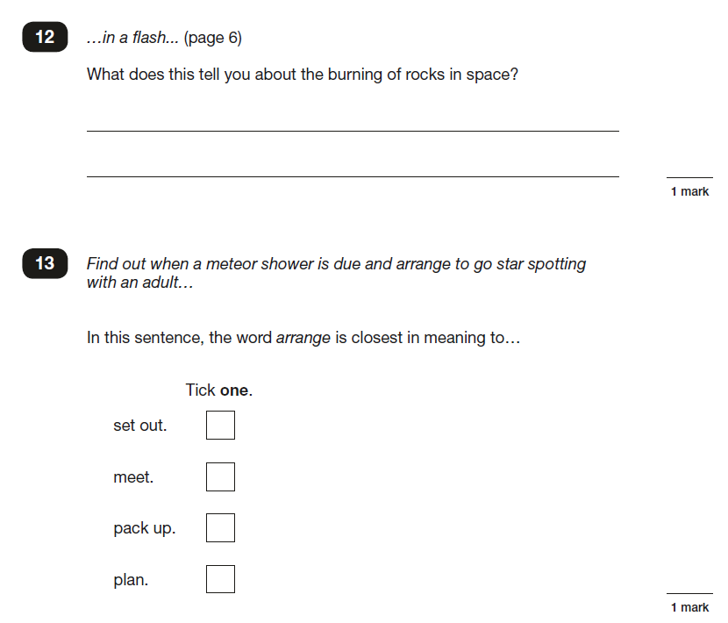
Reading test
Example

Slide 10
The English Grammar, Punctuation and Spelling test
Two components:
a booklet of short-answer questions;
a spelling task.
Paper 1: the short-answer questions, consists of between 40 and 50 questions assessing grammar, punctuation and vocabulary. The questions are:
selected response items (such as multiple choice questions) or
short, open response items, in which children may have to write a word, a few words or a sentence.
Paper 2: the spelling task, consists of 20 sentences, which are read aloud by the teacher.
Rules (these may seem cruel, but there is a very high expectation of Y6 pupils!)
If a capital letter is used incorrectly in the answer it will be marked wrong even if the answer is correct.
The final spelling in the spelling task must be written on the answer line not crossed out and written above.
Sentences must be punctuated correctly (capital letter and full stop, etc.).
Children must use the correct size and orientation of letters and punctuation marks.

Slide 11
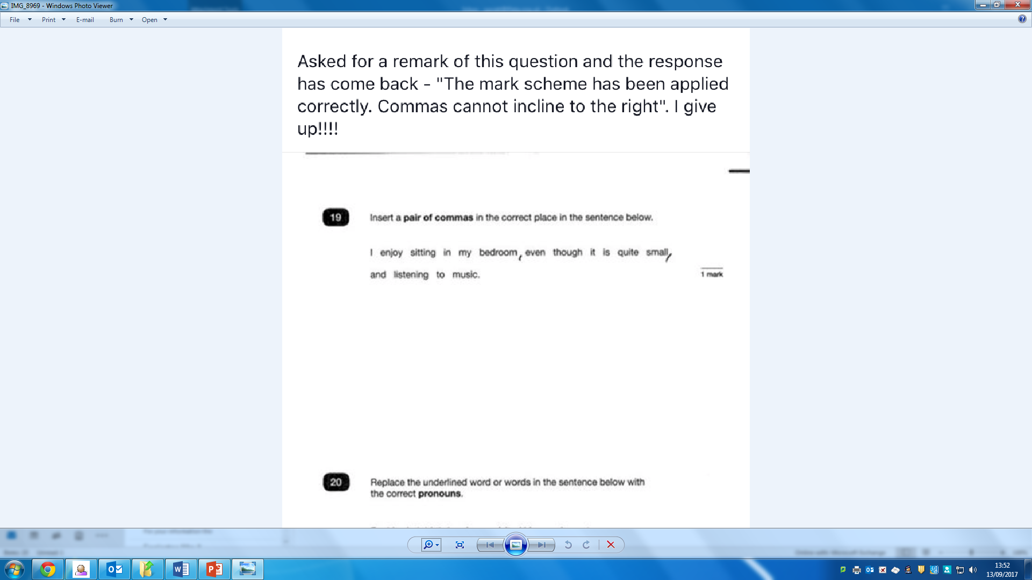

Slide 12
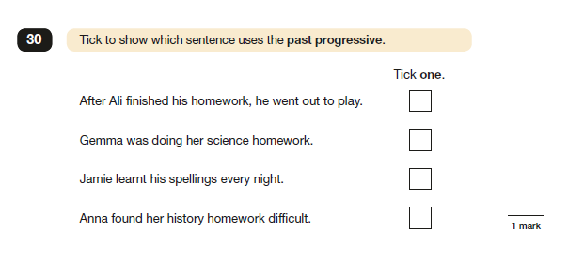
Grammar test
Example 1

Slide 13
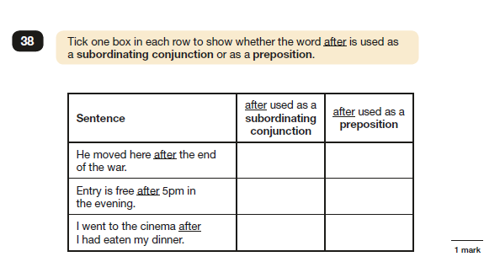
Grammar test
Example 2

Slide 14
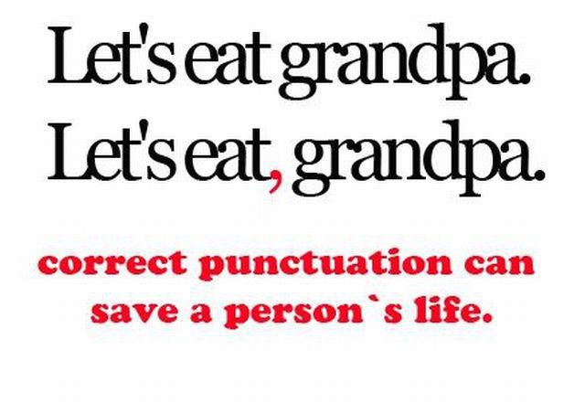
Understanding Grammar
(Progression document)
http://www.lfatg.org.uk/wp-content/uploads/sites/7/2014/11/lfatg-grammar-progression-for-parents.pdf

Slide 15

Writing
There is no longer a writing test. Children will produce a portfolio of writing throughout the year and will be assessed internally against the writing standards for Y6.

Slide 16
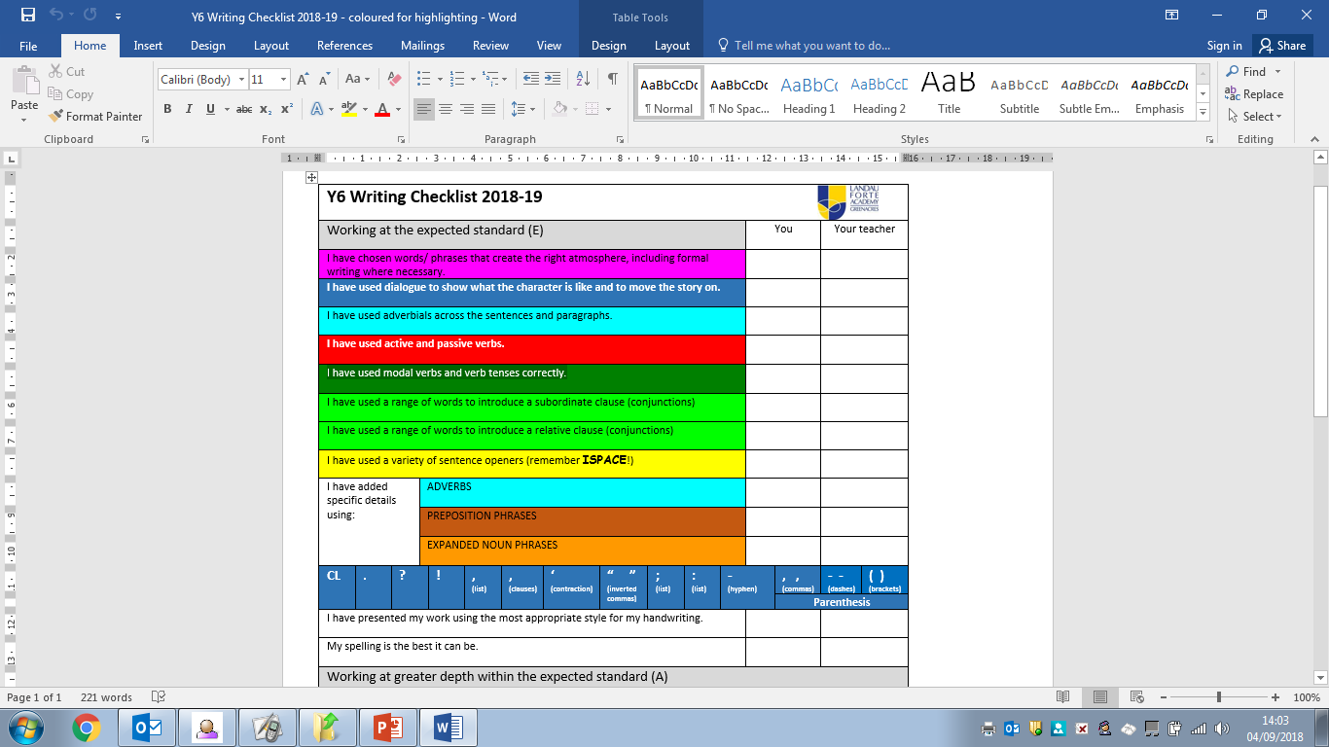

Slide 18
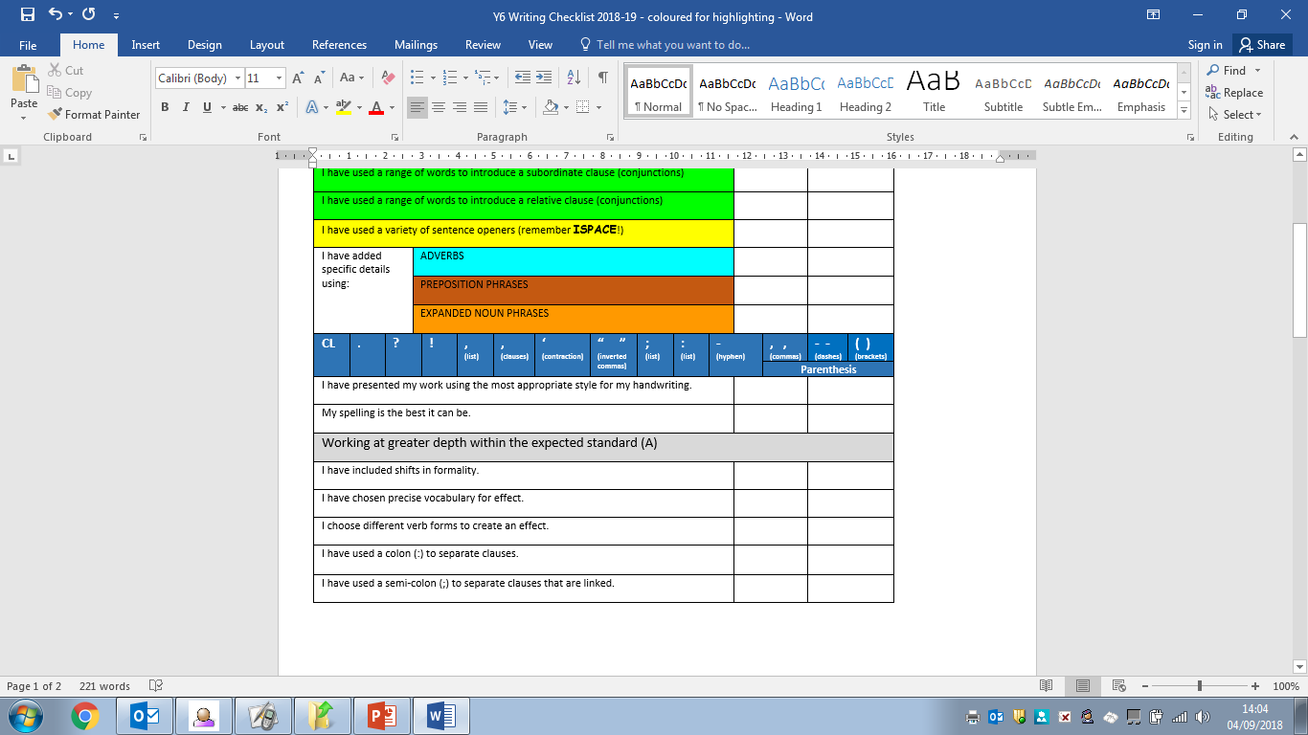

Slide 19
Writing
There will be opportunities to produce lots of different types of writing (e.g. stories, letters, reports, balanced arguments, etc.).
Children must show that they can use high levels of sentence construction, spellings, punctuation and language effectively.

Slide 22
Writing
Handwriting and presentation are extremely important and can be the difference between a child reaching expected standard or not.
Children must use capital letters correctly (i.e. starts of sentences, to start names, capital “I”).
Children must check for spelling errors independently and spell correctly.
Handwriting must be of consistent size and should be sitting on the line!

Slide 23
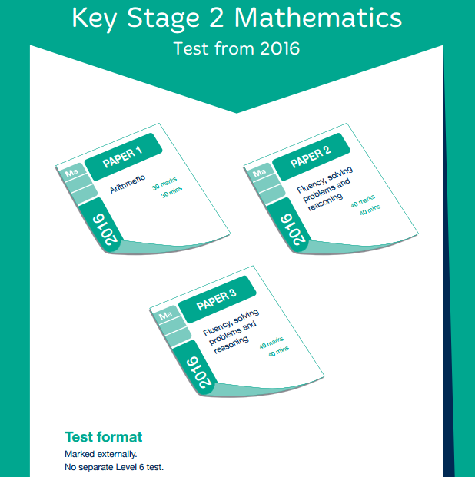
SATS

Slide 24
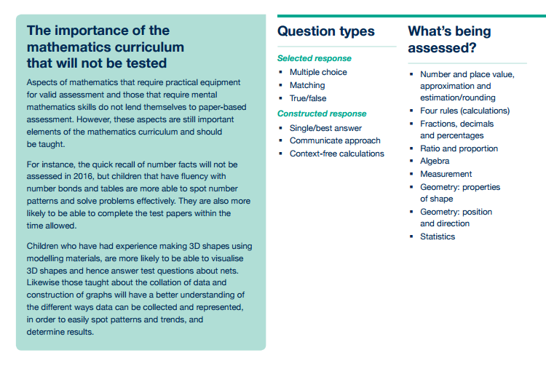
SATS

Slide 25
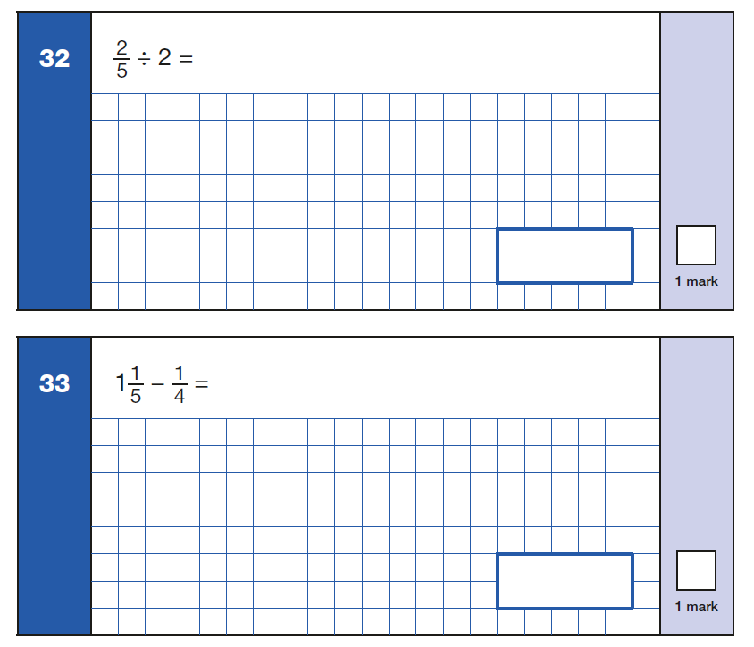
Arithmetic
Arithmetic test
Examples

Slide 26
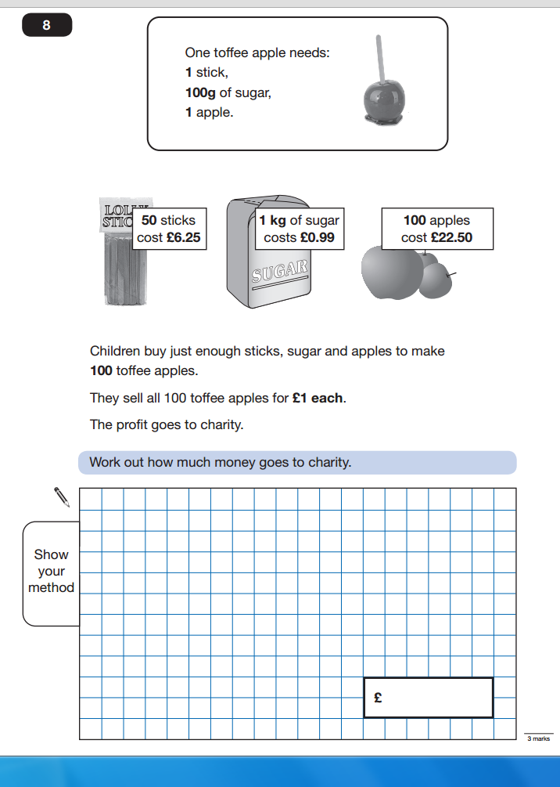
Fluency, solving problems and reasoning
NO CALCULATORS ARE
ALLOWED ON ANY
MATHS PAPER
Maths test
Example

Slide 27


Maths Progression
http://www.lfatg.org.uk/wp-content/uploads/sites/7/2013/05/lfatg-maths-progression-for-parents.pdf

Slide 28

Revision for SATs
https://www.middletonprimaryschool.co.uk/page/?title=Year+6+SATs+revision&pid=180

Slide 29
Life after levels
All children will do all tests; there is no longer a higher ability test.
Children will not be given a National Curriculum level; results will be given in the form of a standardised score (with 100 being the required score to pass – or “secondary ready”; 110 means “greater depth” or higher level).
Higher expectations for learning and self-responsibility for learning.
Intensive support in school throughout the year for all abilities.
Support and encouragement from home is vital!

Slide 30

Social media
It is a parent’s responsibility to know what their child is accessing and who they are communicating with.
Too many school hours have been taken up dealing with issues on social media!
Ensure that you have control of your child’s phone and know which apps they are accessing and who they are talking to. Is it age appropriate?
We do not have access to your child’s phone so it is difficult for us to solve these problems when incidents are happening outside of school.

Slide 31
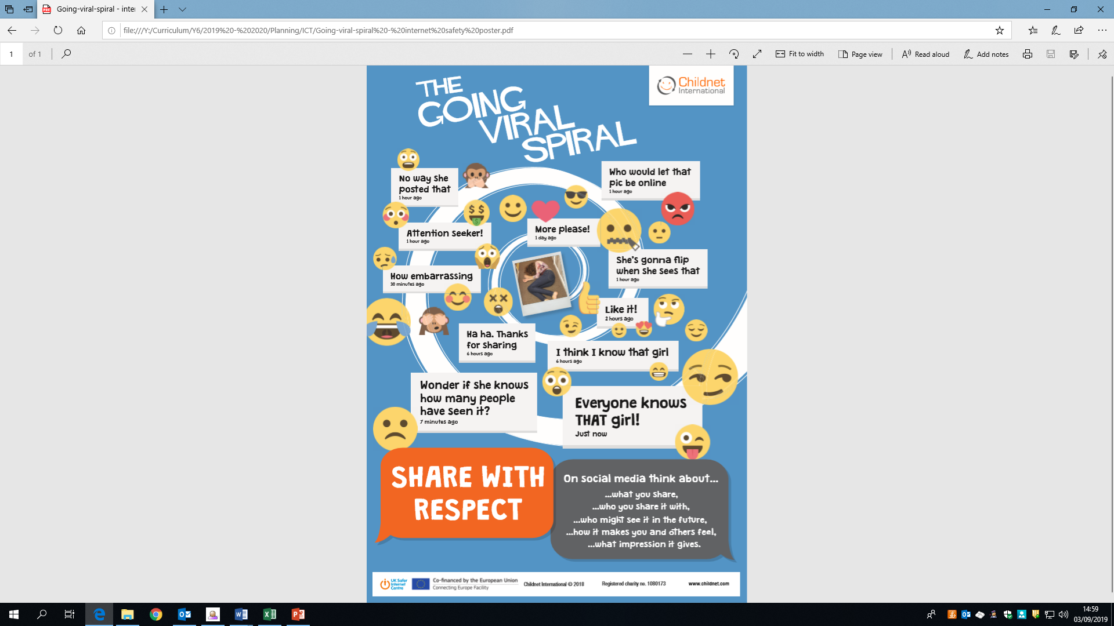

Slide 32
End of year events
End of term celebrations have got bigger each year with parents wanting their children to have a memorable end to their time at primary school.
Limousines, hoodies, prom – these are not organised by the school staff.
We are not responsible for collecting money, or sorting the organisation or behaviour for these events.
School arranges the leavers’ presentation, BBQ and the leavers’ book.
Last day of term should be enjoyed by all the children – if you require your child to leave site to “get ready” for the evening prom, they will only be allowed to leave during the 45-minute lunch break (12:30 – 1:15pm), returning for the afternoon session.

Slide 33

Expectations for Y6
Children need to “opt-in” to everything.
They must take responsibility for their own actions and learning – Y6 jobs (prefects, eco warriors, etc.).
Homework – reading, practising spellings, MyMaths and times tables.
Spellings – learn fortnightly and use in written work.
Home/school diary – signed by parents (raffle tickets).
Reading at least 5 times per week.
Breadth of reading (see grids at back of diaries).
Behaviour (in and out of classroom).
Rewards (reading grid awards, learning passes, class merits, half-termly spelling 100% club, good work assembly, housepoints).

Slide 34

Contact details:
ppratt@lfatg.org.uk
kmclaughlin@lfatg.org.uk

